Slide 1

18.404/6.840 Lecture 2
Last time: (Sipser §1.1) - Finite automata, regular languages - Regular operations $∪, ∘, ∗$
- Regular expressions - Closure under $∪$
Today: (Sipser §1.2 – §1.3) - Nondeterminism - Closure under $∘$ and $∗$
- Regular expressions → finite automata
Goal: Show finite automata equivalent to regular expressions
1

Slide 2
Problem Sets
- 35% of overall grade
- Problems are hard! Leave time to think about them.
- Writeups need to be clear and understandable, handwritten ok.
Level of detail in proofs comparable to lecture: focus on main ideas.
Don’t need to include minor details.
- Submit via gradescope (see Canvas) by 2:30pm Cambridge time.
Late submission accepted (on gradescope) until 11:59pm following day:
1 point (out of 10 points) per late problem penalty.
After that solutions are posted so not accepted without S3 excuse.
- Optional problems:
Don’t count towards grade except for A+.
Value to you (besides the challenge):
Recommendations, employment (future grading, TA, UROP)
- Problem Set 1 is due in one week.
2

Slide 3









Closure Properties for Regular Languages
Theorem: If ${ A}_{1}, A_{2}$are regular languages, so is $A_{1}A_{2}$ (closure under $∘$)
Recall proof attempt: Let $M_{1}=(Q_{1}, Σ, { δ}_{1}, { q}_{1}, { F}_{1})$ recognize $A_{1}$ $M_{2}=(Q_{2}, Σ, { δ}_{2}, { q}_{2}, { F}_{2})$ recognize $A_{2}$
Construct $M = (Q, Σ, δ, q0, F)$ recognizing ${A_{1}A}_{2}$
$$M_{1}$$
$$M_{2}$$
$M$ should accept input $w$ if $w=xy$ where $M_{1}$ accepts $x$ and $M_{2}$ accepts $y$.
$$M$$
$$w$$
$$x$$
$$y$$
Doesn’t work: Where to split $w$?
Hold off. Need new concept.
3

Slide 4
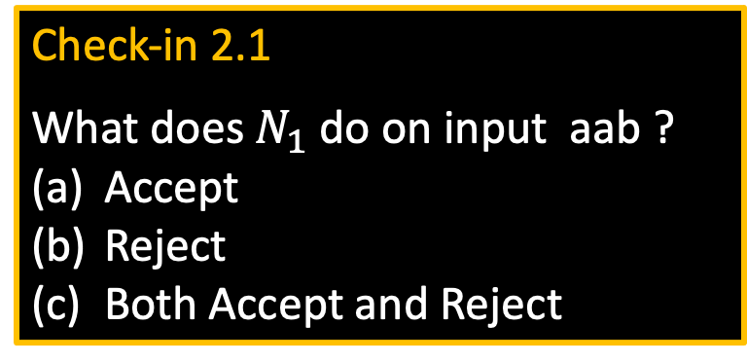





Nondeterministic Finite Automata
$$N1$$
a
a
Check-in 2.1
What does $N_{1}$ do on input aab ?
Accept
Reject
Both Accept and Reject
b
a,ε
$$q4$$
$$q1$$
$$q2$$
$$q3$$
b
Acceptance overrules rejection
New features of nondeterminism: - multiple paths possible (0, 1 or many at each step)
- ε-transition is a “free” move without reading input
- Accept input if some path leads to accept
Example inputs:
- ab accept
- aa reject
- aba accept
- abb reject
Accept the input if some path leads to an accept.
Check-in 2.1
Nondeterminism doesn’t correspond to a physical machine we can build. However, it is useful mathematically.
Once the machine had all possibilities have died off, there is no way for them to come back to life on any extensions
4

Slide 5


NFA – Formal Definition
$$N1$$
a
a
b
a,ε
$$q4$$
$$q1$$
$$q2$$
$$q3$$
b
Defn: A nondeterministic finite automaton (NFA) $N$ is a 5-tuple $(Q, Σ, δ, q0, F)$
- all same as before except $δ$
- $δ:Q×Σ_{\text{ε}}→𝓟\left(Q\right)=\left\{R\right|R⊆Q\}$
- In the $N_{1}$ example: $δ\left(q_{1},\text{a} \right)=\{q_{1},q_{2}\}$
$δ\left(q_{1},\text{b} \right)= ∅$
Ways to think about nondeterminism:
Computational: Fork new parallel thread and accept if any thread leads to an accept state.
Mathematical: Tree with branches. Accept if any branch leads to an accept state.
Magical: Guess at each nondeterministic step which way to go. Machine always makes the right guess that leads to accepting, if possible.
states
alphabet
start state
accept states
transition function
power set
Subsets of Q
$$Σ∪\{\text{ε}\}$$
5

Slide 6




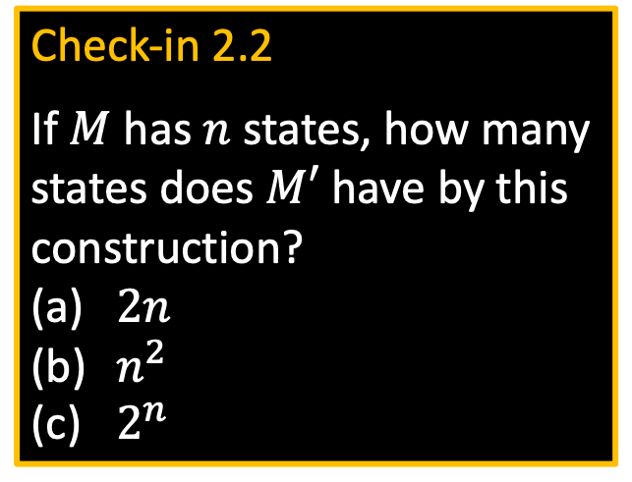




Converting NFAs to DFAs
Check-in 2.2
If $M$ has $n$ states, how many states does $M′$ have by this construction?
$2n$
$n^{2}$
$2^{n}$
Theorem: If an NFA recognizes $A$ then $A$ is regular
Proof: Let NFA $M=(Q, Σ,δ, { q}_{0}, F)$ recognize $A$ Construct DFA $M′=(Q′, Σ,δ′, { q}_{0}^{′}, F′)$ recognizing $A$
(Ignore the ε-transitions, can easily modify to handle them)
IDEA: DFA $M′$ keeps track of the subset of possible states in NFA $M$.
$$M′$$
Construction of $M′$:
$Q′=𝓟\left(Q\right)$
$δ^{′}\left(R,a\right)=\left\{q\right| q∈δ(r,a)$ for some $r∈R\}$
$q_{0}^{′}=\{q_{0}\}$
$F′=\left\{R∈Q^{′}\right| R$ intersects $F\}$
$$M$$
$${ q}_{3}$$
${ \{q}_{3}$,$q_{7}\}$
$R∈Q′$
$${ q}_{7}$$
NFA
DFA
Check-in 2.2
6

Slide 7




Return to Closure Properties
Recall Theorem: If $A_{1}, A_{2}$are regular languages, so is $A_{1}∪A_{2}$ (The class of regular languages is closed under union)
New Proof (sketch): Given DFAs $M_{1}$ and $M_{2}$ recognizing $A_{1}$ and$A_{2}$ Construct NFA $M$ recognizing $A_{1}∪A_{2}$
$$M$$
$$M_{1}$$
Nondeterminism parallelism vs guessing
ε
$$M_{2}$$
ε
7

Slide 8

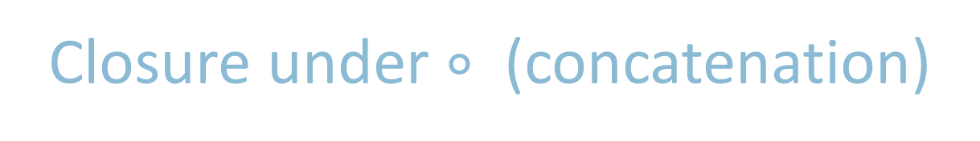






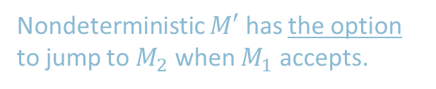
Closure under $∘$ (concatenation)
Theorem: If $A_{1}, A_{2}$are regular languages, so is $A_{1}A_{2}$
Proof sketch: Given DFAs $M_{1}$ and $M_{1}$ recognizing $A_{1}$ and$A_{2}$ Construct NFA $M$ recognizing $A_{1}A_{2}$
$$M$$
$$M_{1}$$
$$M_{2}$$
ε
$M$ should accept input $w$ if $w=xy$ where $M_{1}$ accepts $x$ and $M_{2}$ accepts $y$.
ε
$$w=$$
$$x$$
$$y$$
Nondeterministic $M′$ has the option to jump to $M_{2}$ when $M_{1}$ accepts.
Putting in an empty(epsilon) transitions going from the accept state of M1 to the start of M2
8

Slide 9











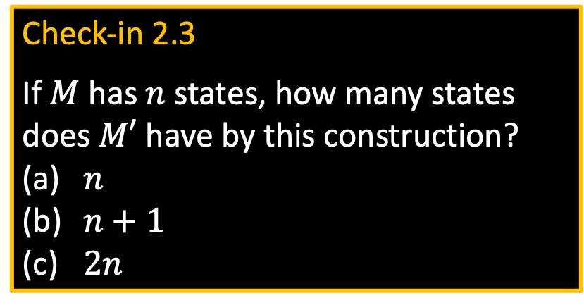
Closure under $∗$ (star)
Check-in 2.3
If $M$ has $n$ states, how many states does $M′$ have by this construction?
$n$
$n+1$
$2n$
Theorem: If $A$ is a regular language, so is $A^{∗}$
Proof sketch: Given DFA $M$ recognizing $A$ Construct NFA $M′$ recognizing $A^{∗}$
$$M′$$
$$M$$
ε
$M′$ should accept input $w$
if $w=x_{1}x_{2} … x_{k}$
where $k≥0$ and $M$ accepts each $x_{i}$
ε
ε
$$w=$$
$$x_{1}$$
$$x_{2}$$
$$x_{3}$$
$$x_{4}$$
Make sure $M′$ accepts ε
Check-in 2.3
9

Slide 10
























Regular Expressions $→$ NFA
Theorem: If $R$ is a regular expr and $A=L\left(R\right)$ then $A$ is regular
Proof: Convert $R$ to equivalent NFA $M$:
If $R$ is atomic:
$R=a$ for $a∈Σ$
$R=ε$
$R=∅$
If $R$ is composite:
$R=R_{1}∪R_{2}$
$R=R_{1}∘R_{2}$
$R=R_{1}^{∗}$
Equivalent $M$ is:
$$a$$
Example:
Convert ${\left(\text{a}∪\text{ab}\right)}^{∗}$ to equivalent NFA
$\text{a}$:
$\text{b}$:
$\text{ab}$:
$\text{a}∪\text{ab}$:
${\left(\text{a}∪\text{ab}\right)}^{∗}$:
$$\text{a}$$
$$\text{b}$$
$$\text{a}$$
$$ε$$
$$\text{b}$$
}
$$ε$$
$$\text{a}$$
$$\text{a}$$
$$ε$$
$$\text{b}$$
Use closure constructions
$$ε$$
$$ε$$
$$ε$$
$$\text{a}$$
$$ε$$
$$\text{a}$$
$$ε$$
$$\text{b}$$
$$ε$$
10
$$ε$$

Slide 11

Quick review of today
Nondeterministic finite automata (NFA)
Proved: NFA and DFA are equivalent in power
Proved: Class of regular languages is closed under $∘, ∗$
Conversion of regular expressions to NFA
Check-in 2.4
Recitations start tomorrow online (same link as for lectures). They are optional, unless you need more help. You may attend any recitation(s). Which do you think you’ll attend? (you may check several)
(a) 10:00 (b) 11:00 (c) 12:00
(d) 1:00 (e) 2:00 (f) I prefer a different time (please
post on piazza, but no promises)
Check-in 2.4
11

Slide 12
MIT OpenCourseWare
https://ocw.mit.edu
18.404J Theory of Computation
Fall 2020
For information about citing these materials or our Terms of Use, visit: https://ocw.mit.edu/terms.

